Slide 1
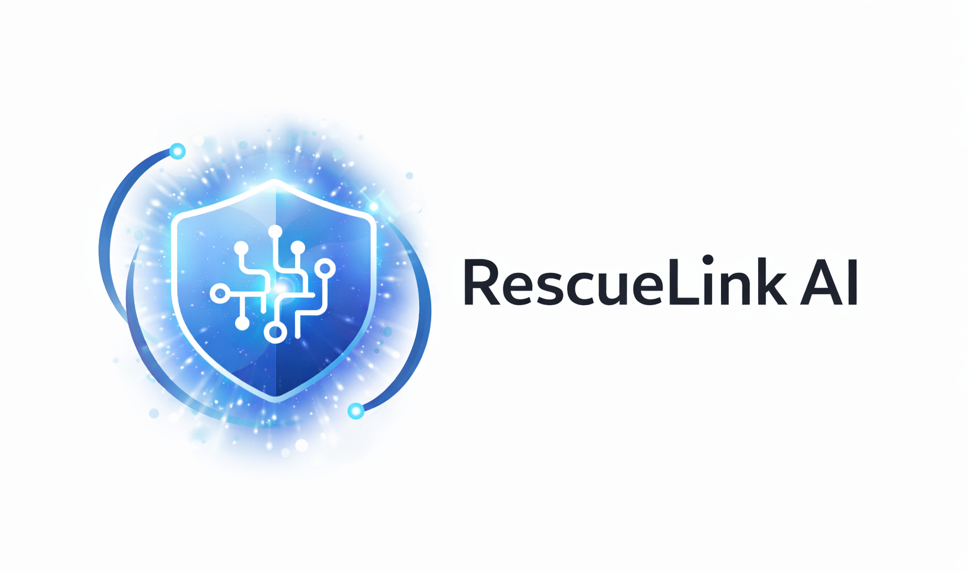

RescueLink AI “When seconds matter, intelligence responds.”
Team Name – Silver Strikers
Theme -AI for Inclusive & Real-Time
Emergency Response (SDG-Driven Innovation)

Slide 2

Problem Statement
Emergency response delays cost lives
Users may be unable to speak
Location sharing is often inaccurate
Panic situations reduce clarity
Disabled users lack inclusive emergency tools
Critical Gap
No intelligent, multimodal, inclusive emergency system exists that works instantly.

Slide 3
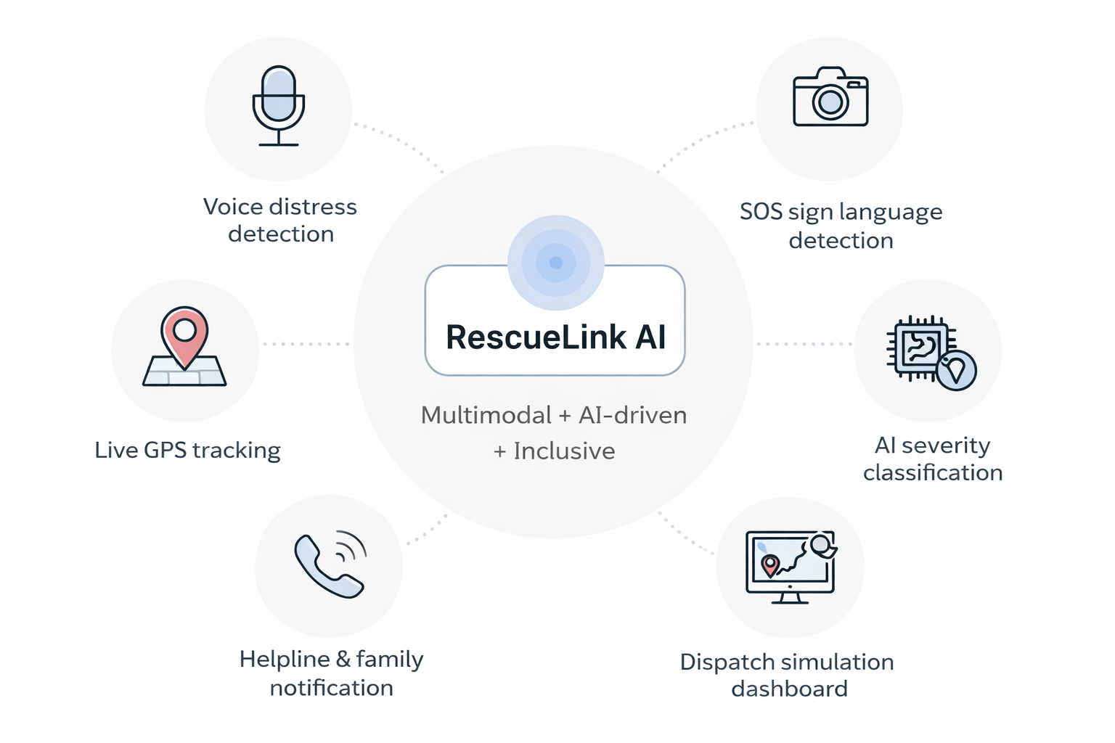
Our Solution
RescueLink AI
An AI-powered emergency system that supports:
🎤 Voice distress detection
📷 SOS sign language detection
📍 Live GPS tracking
🧠 AI severity classification
👮 Dispatch simulation dashboard
📞 Helpline & family notification
Unique Value
Multimodal + AI-driven + Inclusive
“Minimal dependencies for high reliability.”

Slide 4
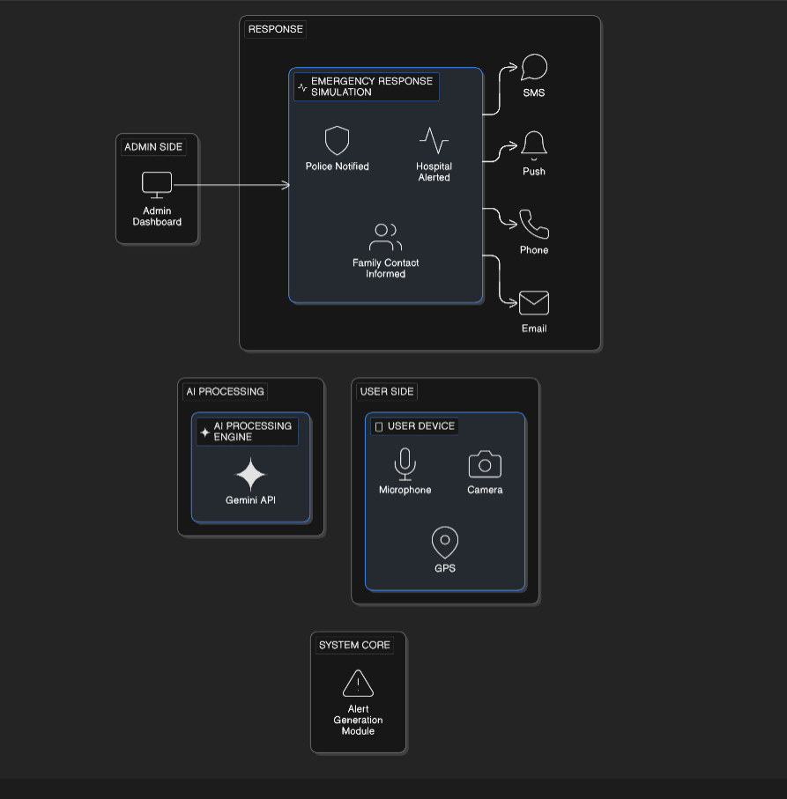
Architecture Diagram

Slide 5
Technology Stack
Layer | Technology
Frontend | React + TypeScript
AI Engine | Gemini API
Voice | Web Speech API
Camera | MediaDevices API
Map | Leaflet + OpenStreetMap
State | React State
Simulation | Local Alert Engine

Slide 6
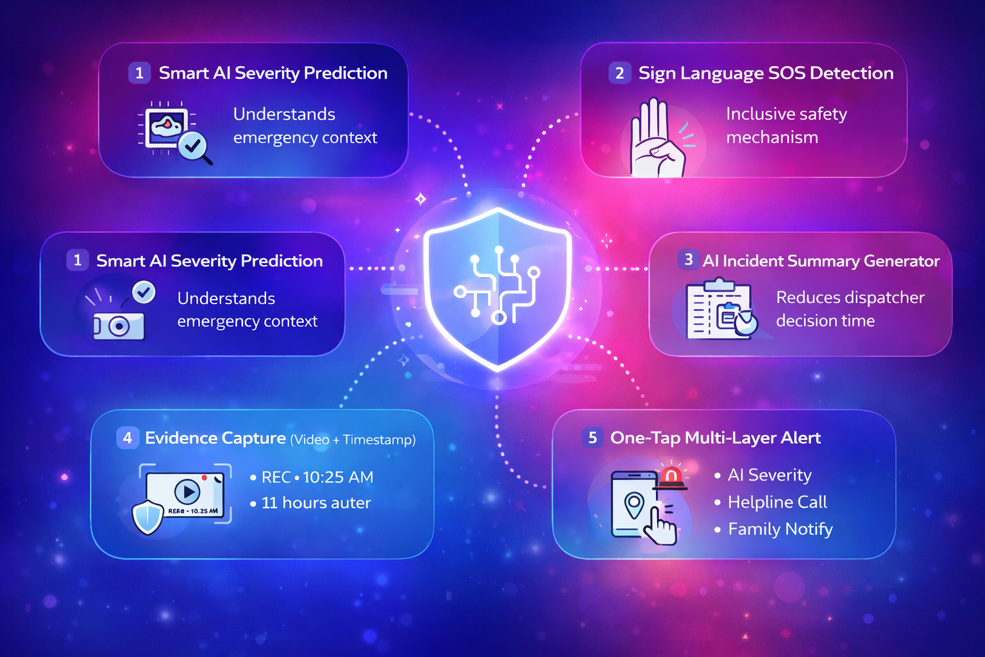
Key Innovations
1️⃣ Smart AI Severity Prediction
Understands emergency context
2️⃣ Sign Language SOS Detection
Inclusive safety mechanism
3️⃣ AI Incident Summary Generator
Reduces dispatcher decision time
4️⃣ Evidence Capture (Video + Timestamp)
5️⃣ One-Tap Multi-Layer Alert
Designed for real-world deployment scalability.

Slide 7
SDG Alignment & Impact
SDG Contribution
Impact Metrics (Projected)
30% faster emergency reporting
Inclusive communication support
Reduced manual dispatcher burden
SDG | Impact
SDG 3 | Faster medical response
SDG 10 | Accessibility for disabled users
SDG 16 | Safer communities
SDG 11 | Smart emergency infrastructure

Slide 8
Feasibility & Future Scope
Feasibility | Future Roadmap
✔ Uses existing browser APIs | Real-time government API integration
✔ Low infrastructure requirement | AI video object detection
✔ Scalable backend integration ready | Risk heatmap analytics
✔ Deployable as web or mobile PWA | Multi-language NLP support
RescueLink AI transforms smartphones into intelligent emergency sensors.

